Slide 1

Predicting Metastatic Breast Cancer Diagnosis
Addressing Healthcare Inequities through Supervised Learning
Aliya

Slide 2
Table of Contents
01
02
03
About the Project
Machine Learning
Insights
backgrounds
to apply Algorithms
from the analysis

Slide 3
01
About the Project
Inequity in Healthcare

Slide 4
Healthcare Inequity
Health inequities are differences in health status or in the distribution of health resources between different population groups , arising from the social conditions in which people are born, grow, live, work and age.
Examples of health inequity include lower life expectancy, high rates of mental ill-health, and difficulty getting healthcare . These widespread differences are the result of systems that negatively affect people's living conditions, access to healthcare, and overall health status.

Slide 5
Overview of the Dataset
Gilead Sciences provides this real-world dataset. The dataset originated from Health Verity, one of the largest healthcare data ecosystems in the US.
Explanation of dataset features: demographics, diagnosis and treatment options, insurance coverage, and environmental factors for patients diagnosed with breast cancer from 2015-2018.
Importance of dataset: Provides valuable insights into the factors influencing timely diagnosis and treatment of metastatic cancer, particularly in the context of healthcare inequity.

Slide 6
Goal of the Project
Metastatic TNBC is considered the most aggressive TNBC and requires most urgent and timely treatment. Unnecessary delays in diagnosis and subsequent treatment can have devastating effects in these difficult cancers. Differences in the wait time to get treatment is a good proxy for disparities in healthcare access.
The primary goal of building these models is to detect relationships between demographics of the patient with the likelihood of getting timely treatment. The secondary goal is to see if environmental hazards impact proper diagnosis and treatment.

Slide 7
Data
Objective
Environmental
Predicting metastatic cancer diagnosis within 90 days of screening
Ozone, PM25, and NO2 levels at zip level
Demographics
Treatment
Avg 59 years, female, 47.68% married, 12.67% divorced, 33.83% never married
novel treatment for metastatic cancer within 90 days of screening
Economic
Education
Income median:$74,374,
8.58% of patients are uninsured, rent burden
Education level, job type (self-employed,, veteran)

Slide 8
02
Machine Learning
You can enter a subtitle here if you need it

Slide 9
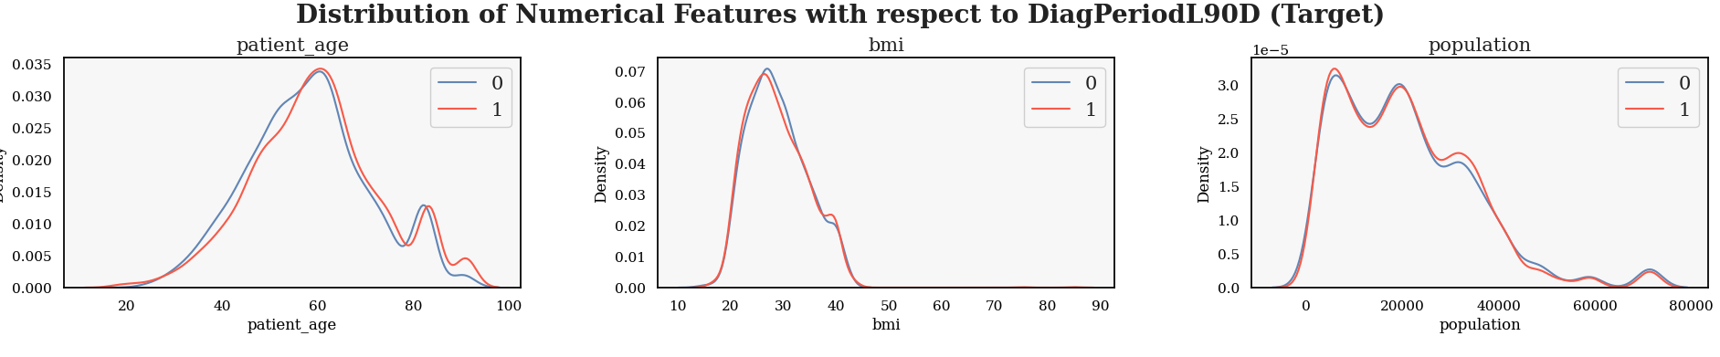
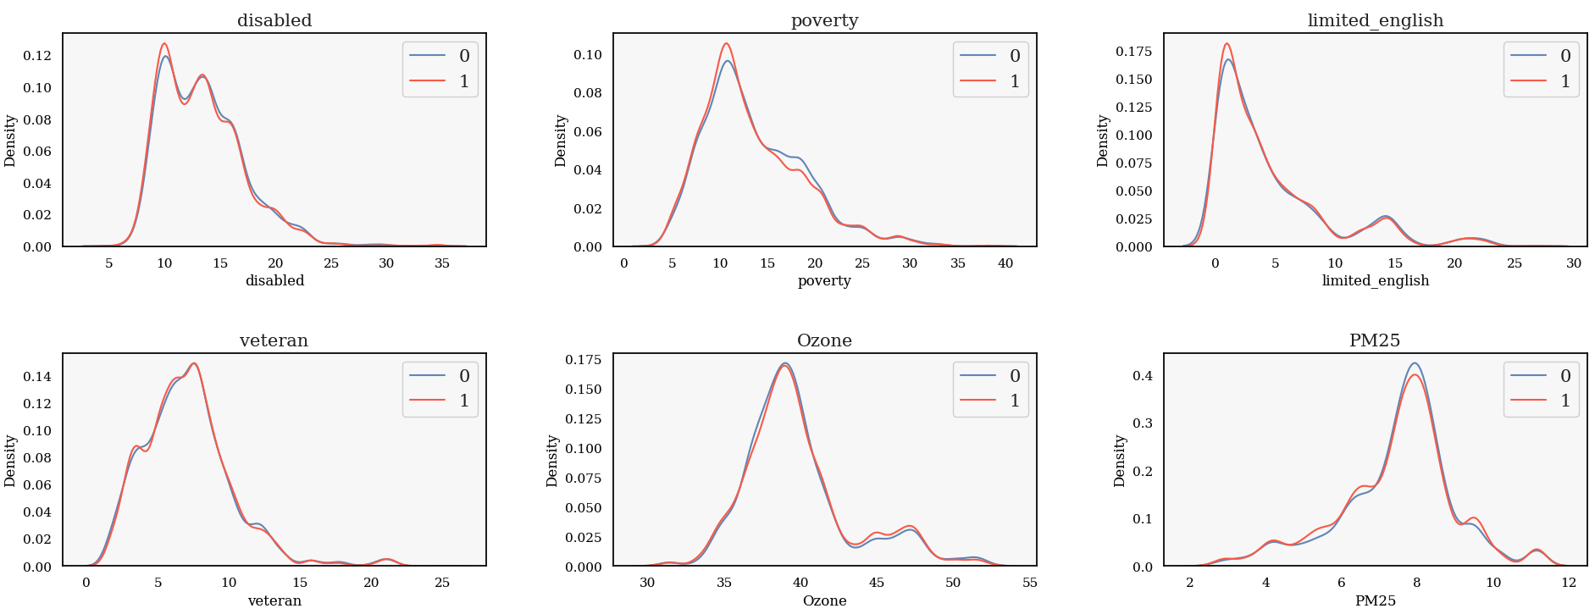
EDA

Slide 10
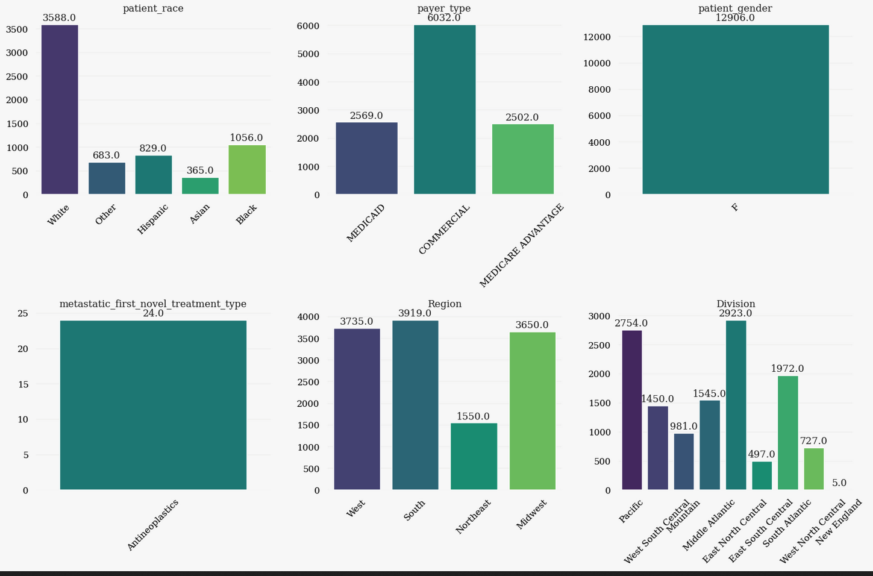
EDA

Slide 11
Feature Selection
Use the DropColumn transformer to remove features that are not expected to have any predictive power or relevance to the target variable
patient_state
patient_zip
patient_age
Breast_cancer_diagnosis_code
Breast_cancer_diagnosis_desc
payer_type
metastatic_cancer_diagnosis_code

Slide 12
Comparison
Classifier | Accuracy
AdaBoost | 0.816809
Gradient Boosting Machine | 0.816034
Multilayer Preceptron | 0.815647
Logistic Regression | 0.815259
LightGBM | 0.809837
XGBoost | 0.804802
Naive Bayes | 0.788923
Random Forest | 0.771882
Extra Tree | 0.750581
Support Vector Machine | 0.626259
K-Nearest Neighbors | 0.619675

Slide 13
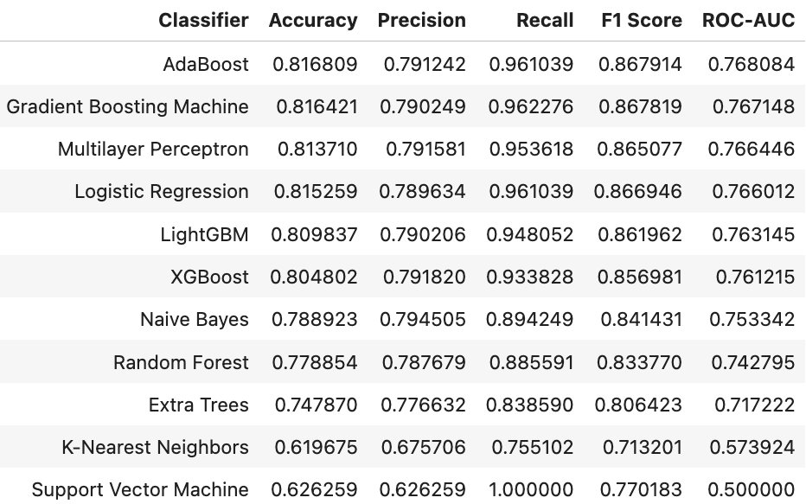
Hyperparameter Tuning - Grid Search

Slide 14
03
Insights
You can enter a subtitle here if you need it

Slide 15

Future Directions
Explore Advanced Neural Network Architectures:
Discuss the potential for advanced neural network architectures, such as CNNs or RNN, to further enhance predictive modeling performance.
These architectures can capture complex patterns in healthcare data, leading to more accurate predictions and insights into healthcare disparities.
Validate Findings with Larger Datasets:
Advocate for validating project findings by applying developed models to larger datasets encompassing diverse patient populations and healthcare settings.
Emphasize the importance of robust validation to ensure the generalizability and reliability of the predictive models.
Collaborate with Healthcare Professionals and Policymakers:
Collaborate with healthcare professionals and policymakers to translate research findings into actionable interventions and evidence-based policies.
Highlight the potential for interdisciplinary partnerships to drive meaningful change in addressing healthcare inequities and improving patient outcomes.

Slide 16
References
https://www.kaggle.com/competitions/widsdatathon2024-challenge1/overview
https://www.kaggle.com/code/ddosad/wids-data-exploration-ml-starter
https://www.kaggle.com/code/thiagomantuani/wids-datathon2024-eda-modeling

